Slide 1
In the name of GOD

Slide 2
Reaction with carbonyl Compounds
Chapter 4

Slide 3
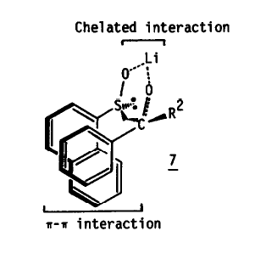
4.1. Reaction of carbonyl compounds with nucleophiles
4.1.1. Addition of organometallic species to carbonyl compounds
Scheme 4.1.

Slide 4
4.1. Reaction of carbonyl compounds with nucleophiles
4.1.1. Addition of organometallic species to carbonyl compounds
Scheme 4.2.

Slide 5
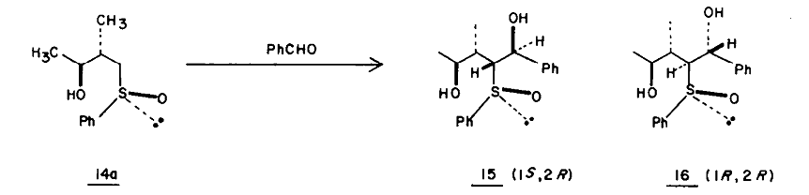
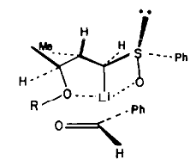
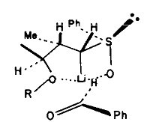
Scheme 4.2.

Slide 6
4.1. Reaction of carbonyl compounds with nucleophiles
4.1.2. Alkylating agent
A
B
Scheme 4.3.
A
B

Slide 7
4.1. Reaction of carbonyl compounds with nucleophiles
4.1.2. Alkylating agent
Scheme 4.4.

Slide 8
Scheme 4.4.

Slide 9
4.1. Reaction of carbonyl compounds with nucleophiles
4.1.2. Alkylating agent
Ti(TADDOL)₂
Scheme 4.6.

Slide 10
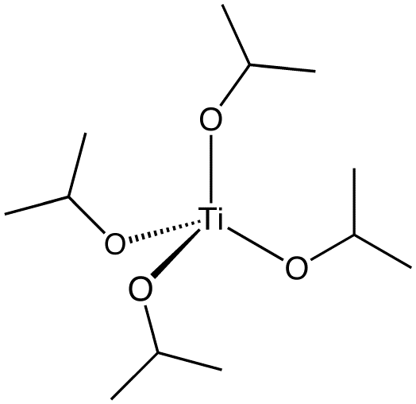
4.1. Reaction of carbonyl compounds with nucleophiles
4.1.2. Alkylating agent
α,α,α,α-tetraaryl-1,3-dioxolane-4,5- dimethanols
Scheme 4.6.

Slide 11
Scheme 4.6.

Slide 12
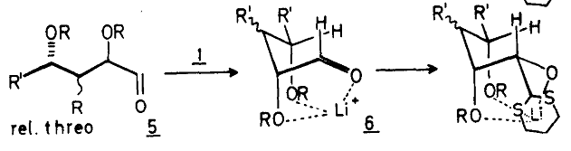
4.1. Reaction of carbonyl compounds with nucleophiles
4.1.3. Homologation procedures
Homologation of an aldhyde =New chiral center at the original carbonyl site
Scheme 4.7.

Slide 13
4.1. Reaction of carbonyl compounds with nucleophiles
4.1.3. Homologation procedures
The (ThTMS) compound is used as a useful reactant, which results in the production of an asymmetric aldehyde product with high space-capability that is used to prepare ancat isomer.
2-(trimethylsilylthiazole = ThTMS

Slide 14
4.1. Reaction of carbonyl compounds with nucleophiles
4.1.3. Homologation procedures

Slide 15
4.1.3. Homologation procedures
Scheme 4.8.

Slide 16
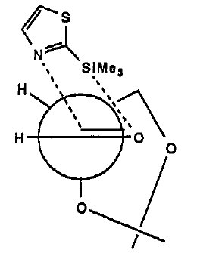
4.1. Reaction of carbonyl compounds with nucleophiles
4.1.3. Homologation procedures
Sequence 1= 1. ThTMS(4.1), CH₂Cl₂, 0˚C
2. NBU₄F, THF
3. NaH, BnBr
Scheme 4.8.

Slide 17
4.1. Reaction of carbonyl compounds with nucleophiles
4.1.3. Homologation procedures
1
Sequence 2= 1. MeI, MeCN
2. NaBH₄, MeOH
3.HgCl₂, MeCN, H₂O

Slide 18
4.1. Reaction of carbonyl compounds with nucleophiles
4.1.3. Homologation procedures
Sequence 1= 1. ThTMS(4.1), CH₂Cl₂, 0˚C
2. NBU₄F, THF
3. NaH, BnBr;
Sequence 2= 1. MeI, MeCN
2. NaBH₄, MeOH
3.HgCl₂, MeCN, H₂O
Scheme 4.8.

Slide 19
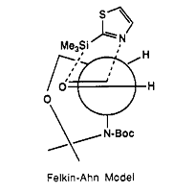
4.1. Reaction of carbonyl compounds with nucleophiles
4.1.3. Homologation procedures
Scheme 4.9.
H⁻

Slide 20
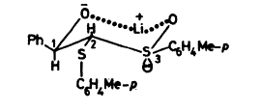
4.1. Reaction of carbonyl compounds with nucleophiles
4.1.3. Homologation procedures
Scheme 4.10.

Slide 21
4.1. Reaction of carbonyl compounds with nucleophiles
4.1.4. Reaction of vinyl anions
Scheme 4.11.

Slide 22
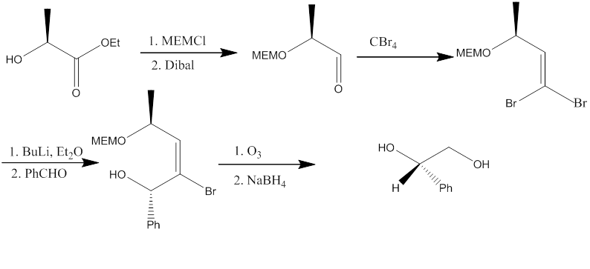
4.1. Reaction of carbonyl compounds with nucleophiles
4.1.4. Reaction of vinyl anions
Scheme 4.12.

Slide 23
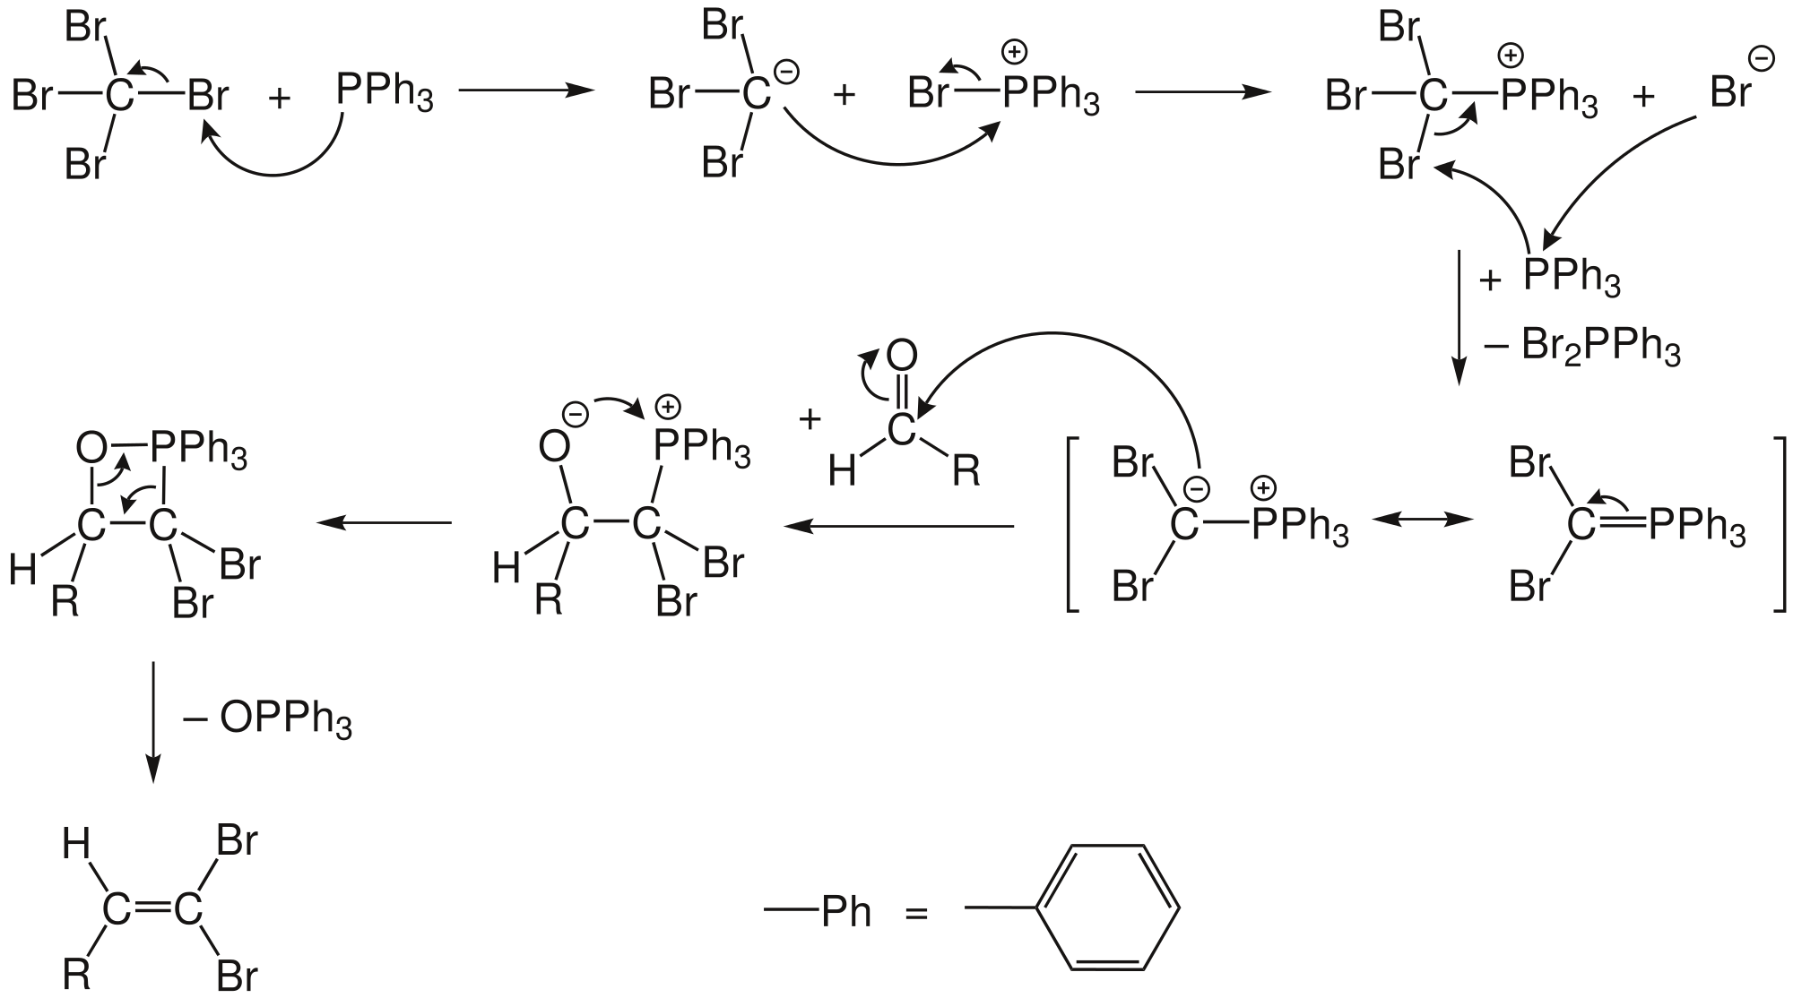
Corey-fuchs reaction mechanism

Slide 24
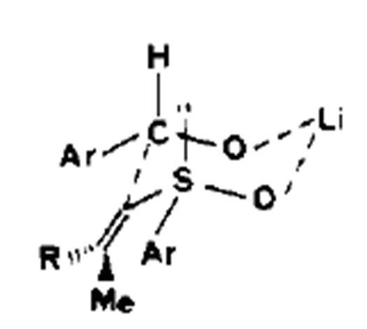
4.1. Reaction of carbonyl compounds with nucleophiles
4.1.4. Reaction of vinyl anions
Scheme 4.13.

Slide 25
4.1. Reaction of carbonyl compounds with nucleophiles
4.1.4. Reaction of vinyl anions
Scheme 4.14.

Slide 26
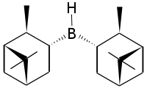

4.1. Reaction of carbonyl compounds with nucleophiles
4.1.5. Use of ‘’Extended’’ organometallic reagents
Scheme 4.15.
Diisopinocampheylborane
S
R
R
S

Slide 27
The addition of allyl organometallic reagents to carbonyl compounds can proceed through four possible cyclic transition states. In this case, the ligand can determine the stereochemical outcome of the reaction.
4.1. Reaction of carbonyl compounds with nucleophiles
4.1.5. Use of ‘’Extended’’ organometallic reagents
Scheme 4.16.

Slide 28
4.1.5.1. Allylboranes
Scheme 4.20.

Slide 29
4.1.5. Use of ‘’Extended’’ organometallic reagents
4.1.5.1. Allylboranes
Scheme 4.18.

Slide 30
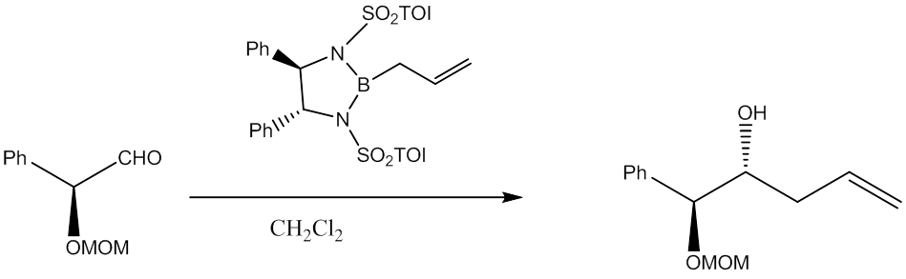
4.1.5. Use of ‘’Extended’’ organometallic reagents
4.1.5.1. Allylboranes
R
Scheme 4.21.
R

Slide 31
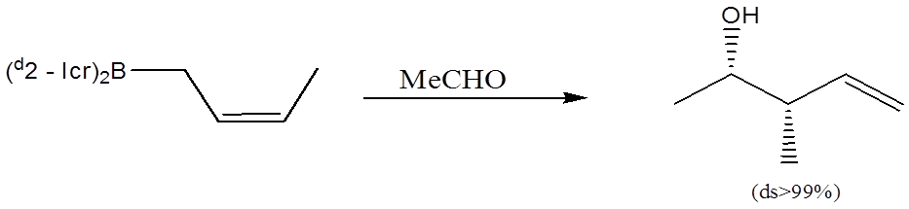
4.1.5. Use of ‘’Extended’’ organometallic reagents
4.1.5.1. Allylboranes
S
S
S
Z
Scheme 4.23.
S

Slide 32
4.1.5. Use of ‘’Extended’’ organometallic reagents
4.1.5.1. Allylboranes
S
S
S
E
Scheme 4.24.
S

Slide 33
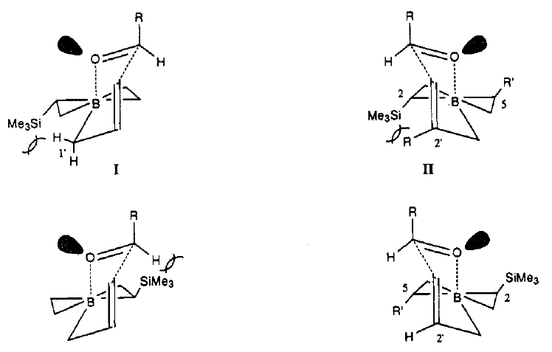
4.1.5. Use of ‘’Extended’’ organometallic reagents
4.1.5.1. Allylboranes
Scheme 4.25.

Slide 34
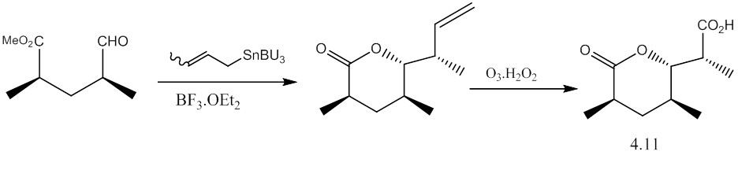
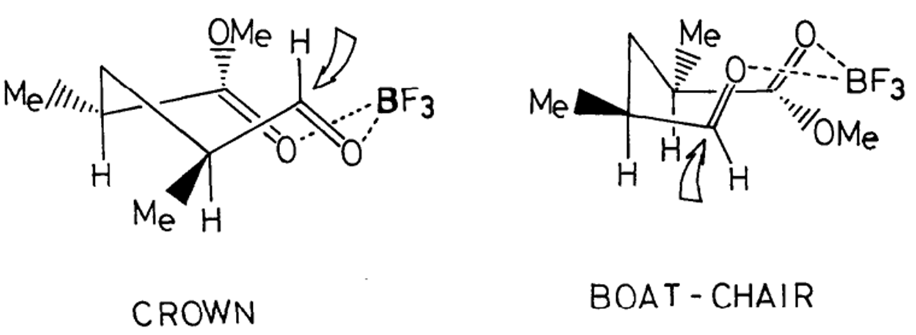
4.1.5. Use of ‘’Extended’’ organometallic reagents
4.1.5.2. Other “ Neutral” Allylic Nucleophiles
R
Scheme 4.26.
R
S

Slide 35
4.1.5. Use of ‘’Extended’’ organometallic reagents
4.1.5.2. Other “ Neutral” Allylic Nucleophiles
R
S
R
Scheme 4.27.
S

Slide 36
4.1.5. Use of ‘’Extended’’ organometallic reagents
4.1.5.2. Other “ Neutral” Allylic Nucleophiles
Scheme 4.28.

Slide 37
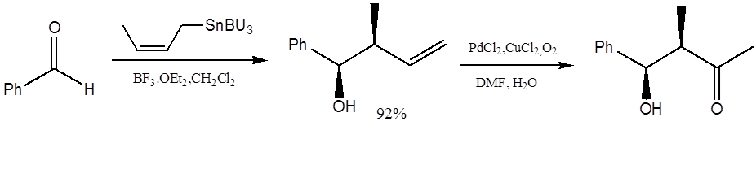
4.1.5. Use of ‘’Extended’’ organometallic reagents
4.1.5.2. Other “ Neutral” Allylic Nucleophiles
Scheme 4.29.

Slide 38
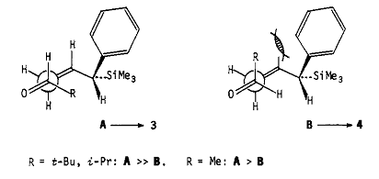
4.1.5. Use of ‘’Extended’’ organometallic reagents
4.1.5.2. Other “ Neutral” Allylic Nucleophiles
S
Scheme 4.30.

Slide 39
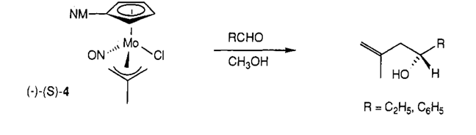
4.1.5. Use of ‘’Extended’’ organometallic reagents
4.1.5.2. Other “ Neutral” Allylic Nucleophiles
Scheme 4.31.

Slide 40
4.1.5. Use of ‘’Extended’’ organometallic reagents
4.1.5.2. Other “ Neutral” Allylic Nucleophiles
Scheme 4.32.
S
S

Slide 41
4.1.5. Use of ‘’Extended’’ organometallic reagents
4.1.5.2. Other “ Neutral” Allylic Nucleophiles
Scheme 4.33.

Slide 42
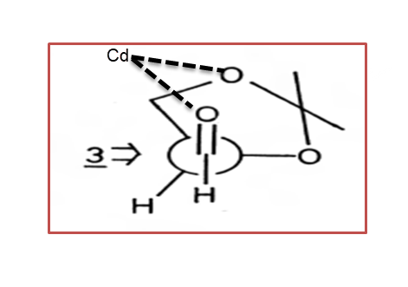
4.1.5. Use of ‘’Extended’’ organometallic reagents
4.1.5.2. Other “ Neutral” Allylic Nucleophiles
=Imd
Scheme 4.34.

Slide 43
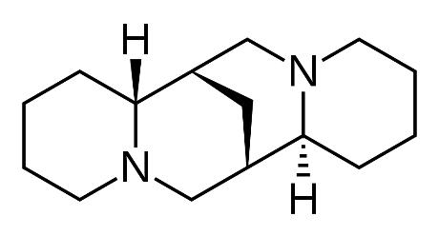
4.1.5. Use of ‘’Extended’’ organometallic reagents
4.1.5.2. Other “ Neutral” Allylic Nucleophiles
R
S
Scheme 4.35.
Sparteine =
Scheme 4.35.

Slide 44
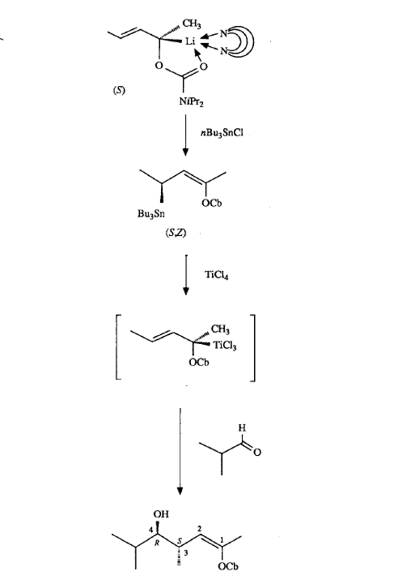
S
R
Scheme 4.35.

Slide 45
4.1.6. Reaction of acetylene and allenic anions
Scheme 4.36.

Slide 46
4.1.6. Reaction of acetylene and allenic anions
Scheme 4.37.

Slide 47
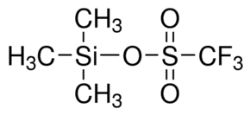
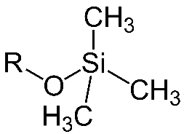
4.2. Acetal reaction
ROTMS=
R
R
R
Scheme 4.38.
R

Slide 48
4.2. Acetal reaction
Scheme 4.39.

Slide 49
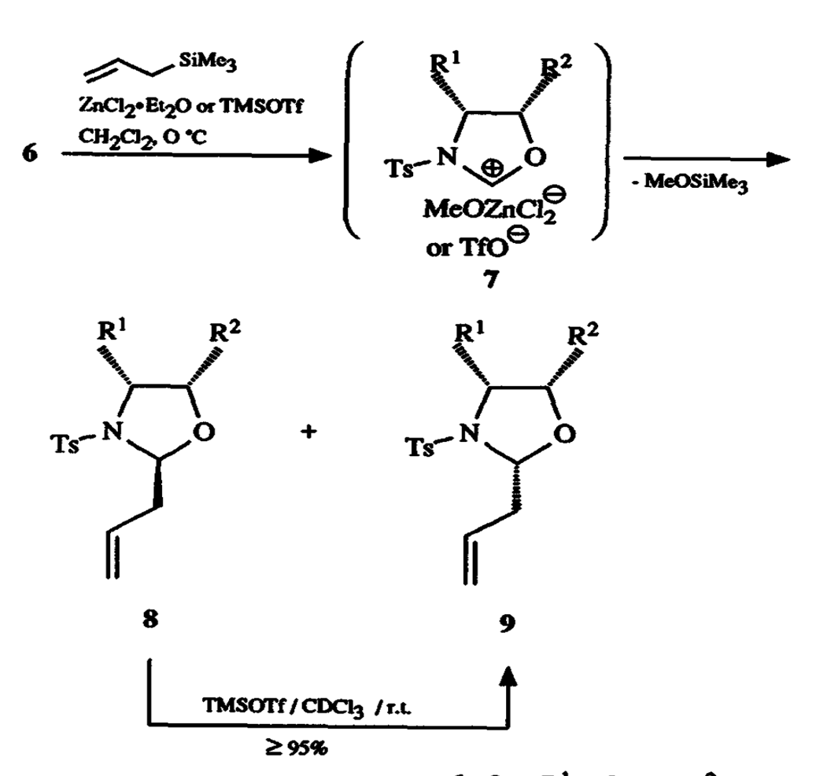
4.2. Acetal reaction
Scheme 4.40.

Slide 50
4.2. Acetal reaction
Scheme 4.42.

Slide 51
4.2. Acetal reaction
Scheme 4.43.

Slide 52
4.3. Other Electrophiles
Scheme 4.44.

Slide 53

4.3. Other Electrophiles
Scheme 4.45.

Slide 54

4.3. Other Electrophiles
Scheme 4.46.

Slide 55
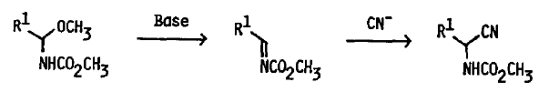
4.3. Other Electrophiles
4.3. Other Electrophiles
Scheme 4.47.
Scheme 4.47.

Slide 56
4.3. Other Electrophiles
Scheme 4.48.

Slide 57
4.3. Other Electrophiles
Scheme 4.49.

Slide 58
4.5. Reductions
4.5.1. Addition to carbonyl compounds
4.5.1.1. Addition to acyclic carbonyl compounds
Scheme 4.51.

Slide 59
4.5. Reductions
4.5.1. Addition to carbonyl compounds
4.5.1.1. Addition to acyclic carbonyl compounds
Reactant-like TS
TS formation is late
Nu is large
Scheme 4.52.
Intermediate complex formed with O of C=O
Equatorial position is occupied

Slide 60
4.5.3. Hydrosilylation
Scheme 4.53.

Slide 61
4.5.5. Metal Hydrides
Reduction by metal hydride can take place by :
1.delivery of the free hydride ion
2.or through electron migration

Slide 62
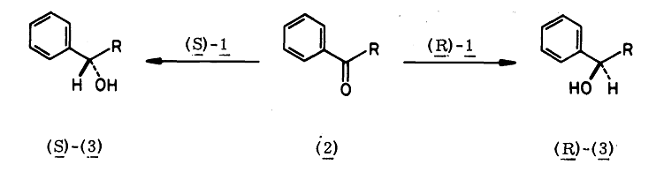
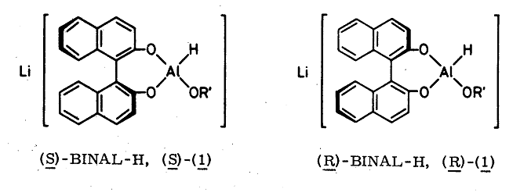
4.5.4.2 . Lithium Aluminum Hydrides
Scheme 4.55.

Slide 63
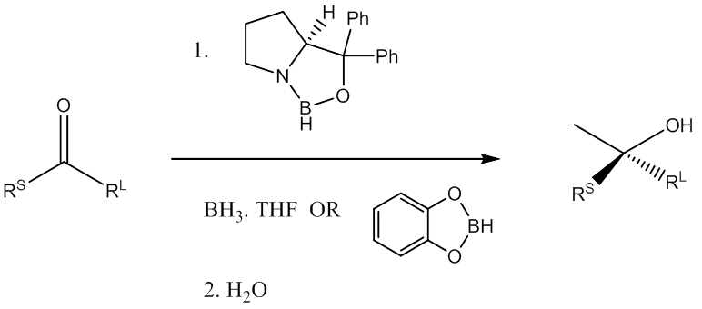
4.5.5. Hydrosilylation
Scheme 4.56.

Slide 64
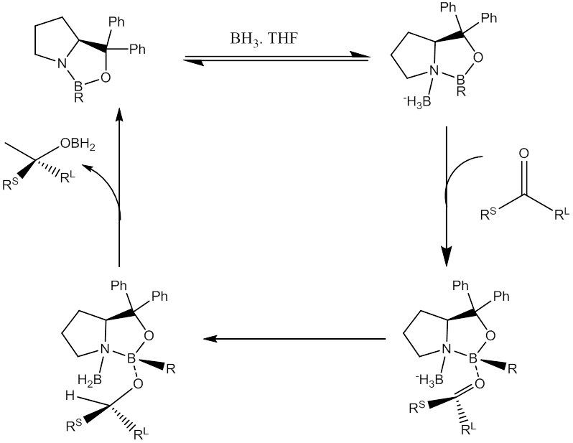

Slide 65
4.5.6. Other Reducing Agent
Scheme 4.58.

