Slide 1
In the name of god

Slide 2
Chapter 3
ONE-CARBON
TRANSFORMATION

Slide 3
INVERSION OF A HYDROXY GROUP
THE MITSUNOBU REACTION
ONE_CARBON TRANSFORMATION
INVERSION AT A SINGLE CARBON CENTER
CHIRAL ORGANOMENTALLIC REAGENTS
OTHER REACTION

Slide 4
This chapter is concerned only with reactions of SP³ centers, where the stereochemistry has already been established.
The conversion of an SP² center to SP³ can also provide, in principle, a one-carbon transformation.

Slide 5
3.1. INVERSION AT A SINGLE CARBON CENTER
The conversion of a pre-existing stereo center to its antipode requires a reaction sequence that has high stereo selectivity.
In general terms, therefore, the examples and methods described below involve an SN₂ reaction - the classical Walden inversion.

Slide 6

Nucleophilic substitution at carbon
SN₂ mechanism

Slide 7
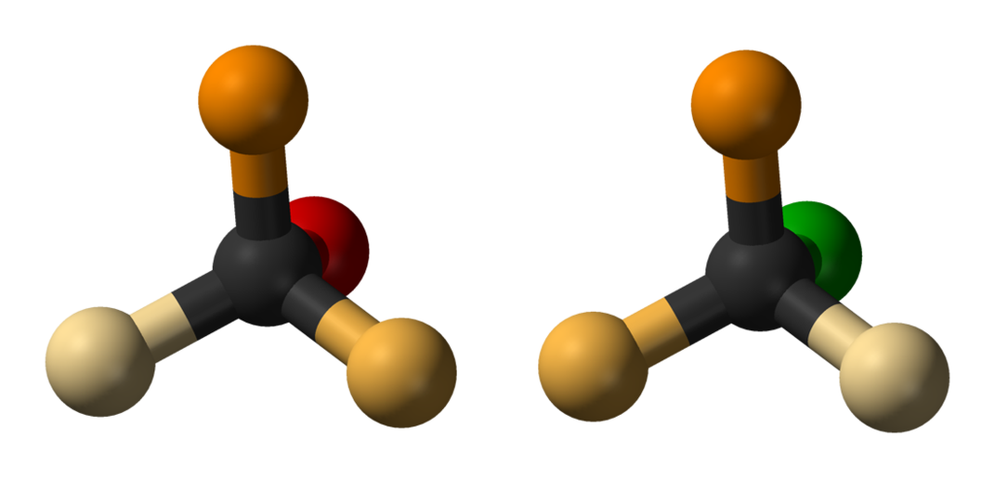
The SN₂ reaction causes inversion of stereo chemical configuration, known as Walden inversion

Slide 8
Conversion of an alcohol to an alkyl halide:
a) Retention of configuration

Slide 9
b) Inversion of configuration

Slide 10
Representative examples of the SN₂ methodology are given in Schemes 3.1 and 3.2
SCHEME 3.1

Slide 11
SCHEME 3.2

Slide 12
SCHEME 3.3

Slide 13
SCHEME 3.4

Slide 14
SCHEME 3.5

Slide 15
On occasion, inversion can occur with high specificity, but is not expected. An example is provided by the reaction of the acid chlorid, 3.6, prepared from ethyl lactate via 3.7, with m-difluorobenzene in the presence of aluminum trichloride (Scheme 3.6).
SCHEME 3.6

Slide 16
Retention of configuration at a specific center is often best achieved by the use of two inversions. This is adequately illustrated by a method based on selenium chemistry for the conversion of an alcohol to an alkyl bromid with an alkyl selenide as the intermediate (Scheme 3.7).
SHEME 3.7

Slide 17
The use of a copper catalyst for the reaction of a metal azide with a mesylate has, however, been observed to provide retention of configuration as opposed to the usual inversion (Scheme 3.8).
SCHEME 3.8

Slide 18
The reaction of the lithium enolate derived from the chiral iron acetyl complex 3.8 shows chiral discrimination in the SN₂ reaction with tert-butyl 2-propionate (Scheme 3.9).
SCHEME 3.9

Slide 19
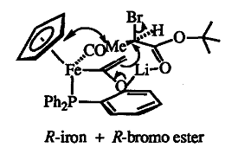

Slide 20
3.1.1. INVERSION OF A HYDROXY GROUP
The inversion of a hydroxy group is not a simple procedure. The most reliable methods are based on Mitsunobu methodology. Inversion can be achieved by conversion of the alcohol to a mesylate or tosylate, then by nucleophilic displacement with potassium superoxide or nitrite in dimethyl sulphoxide.
SCHEME 3.10

Slide 21
MITSUNOBU REACTION
The MITSUNOBU REACTION is an organic reaction that converts an alcohol into a variety of functional groups, such as an ester, using triphenylphosphine and an azodicarboxylate such as diethyl azodicarboxylate (DEAD) or diisopropyl azodicarboxylate (DIAD). The alcohol undergoes an inversion of stereochemistry. It was discovered by Oyo Mitsunobu (1934–2003).

Slide 22
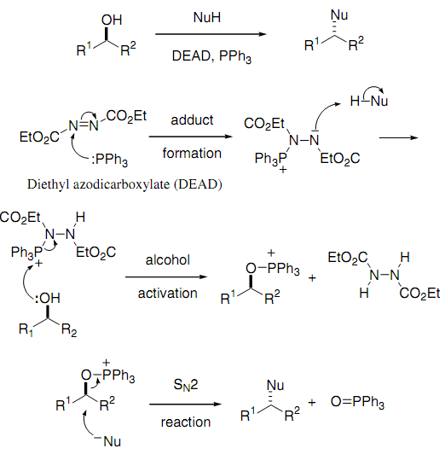

Slide 23
3.1.2. THE MITSUNOBU REACTION
The Mitsunobu reaction allows substitution of a hydroxy group by a wide variety of nucleophiles with inversion of configuration. This Mitsunobu protocol often provides very high yields for unhindered alcohols.
SCHEME 3.11

Slide 24
Amino alcohols provide for nucleophilic substitution under Mitsunobu conditions with stereochemistry being controlled by the nitrogen protection.

Slide 25
Formation of an intermediate oxazoline

Slide 27
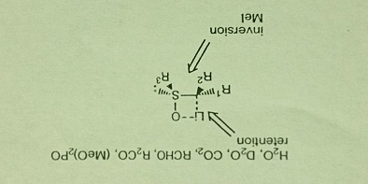
3.2 CHIRAL ORGANOMETALLIC REAGENTS
It is possible to use a nucleophile where the reaction center bears the chirality. The organometallic species must have a stable configuration, otherwise racemization will be observed.
FIGURE 3.1 Reaction of sulfoxide stablized carbanions

Slide 28
The use of these chiral organometallic reagents allows for a wide range of synthetic methods, including the preparation of alcohols by silicon chemistry (Scheme 3.13), and α-alkoxy carboxylic acids (Scheme 3.14).
SCHEME 3.13

Slide 29
Organometallic intermediate

Slide 30
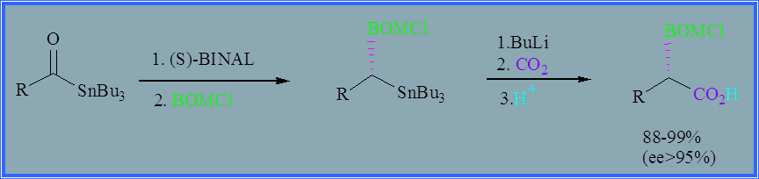
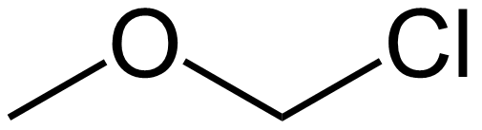
Alkylating agents
SCHEME 3.14
OBOM
OBOM
BOMCl

Slide 31
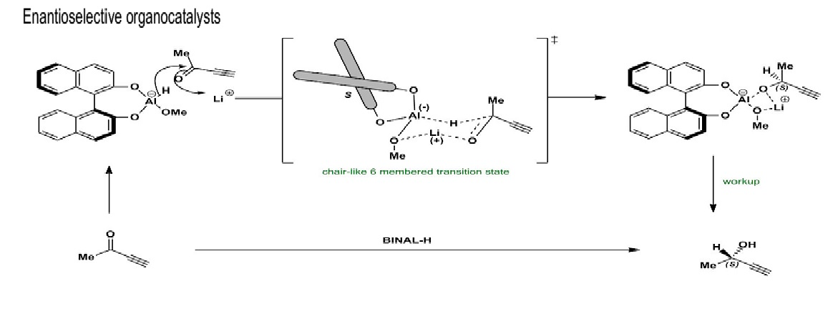

Slide 32
In addition to oxygen and sulfur, other heteroatoms can be incorporated into the organometallic reagent (vide supra), including nitrogen, selenium, silicon, and halogens (Scheme 3.15).
SCHEME 3.15

Slide 34
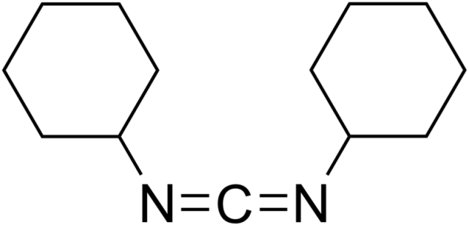
3.3 OTHER REACTIONS
An example is provided by the kinetic resolution of phenylethanol with the chiral carboxylic acid 3.9 (Scheme 3.16).
SCHEME 3.16

Slide 35
SUMMARY
Substitution at an sp3 center is a reaction that has to be undertaken with care. Although the Mitsunobu reaction provides methodology for unhindered centers, problems can still occur when steric demands are high.
For a classical SN2 reaction, systems that contain an adjacent activating functional group, such as a carbonyl group or boron, provide the highest stereochemical control. Other than cost considerations, these nucleophilic substitution reactions can be scaled up.

