Slide 1
Chapter 2
General Rules

Slide 2
Chapter 2
2.1. Carbonyl Additions
2.1.1. Anh-Felkin Addition
2.1.2. Chelation Controlled Addition
2.1.3. Dipolar Addition
2.1.4. Prelog’s Rule
2.2. Houk’s Rule
2.3. Allylic Strain
2.4. Baldwin’s Rule
2.4.1. Carbonyl Compounds
2.5. Pericyclic Transition States
2.5.1. Woodward-Hoffmann Rules
2.5.2. Stereochemical Consequences

Slide 3
Carbonyl Additions
Cram Addition
1
Anh-Felkin Addition
2
3
Chelation Controlled Addition
Dipolar Addition
4
Prelog’s Rule
5
2

Slide 4
Cram Addition
Nu:
Minor
product
Nu:
Major
product
3

Slide 5
4

Slide 6
5

Slide 7
Ahn-Felkin Addition
Favored
Dis-favored
6

Slide 8
Figure 2.3.
7

Slide 9
Scheme 2.4.
8

Slide 10
Chelation Controlled Addition
Scheme 2.5.
9

Slide 11
Scheme 2.7.
10

Slide 12
Scheme 2.8.
11

Slide 13
Oxygen groups at C-2 and C-3 position
syncat
ancat
12

Slide 14
Scheme 2.9.
syncat
13

Slide 15
Scheme 2.10.
Scheme 2.11.
14

Slide 16
Scheme 2.12.
Scheme 2.12.
15

Slide 17
R=Ph ds 1:1
R=OCH₂OBn ds 8:1
Scheme 2.13.
16

Slide 18
Dipolar Addition
Scheme 2.14.
17

Slide 19
Prelog’s Rule
Figure 2.9.
1
18

Slide 20
Scheme 2.15.
19

Slide 21
Scheme 2.16.
20

Slide 22
Houck’s Rule
X=C or O
Figure 2.11.
1
21

Slide 23
Figure 2.12.
22

Slide 24
Scheme 2.17.
23

Slide 25
Scheme 2.18.
syncat | Ancat | %Yield | R
50 | 50 | 100 | H
21 | 79 | 99 | SiMe₂Bu-t
21 | 79 | 97 | SiMe₂Th
11 | 89 | 96 | SiPh₂Bu- t
24

Slide 26
Scheme 2.19.
R² >>> R¹
25

Slide 27
Scheme 2.20.
26

Slide 28
Allylic Strain
27

Slide 29
Allylic strain for the β-substituted system
Figure 2.16.
28

Slide 30
Figure 2.17.
29

Slide 31
Scheme 2.21.
30

Slide 32
Baidwin’s Rule
Scheme 2.22.
Scheme 2.23.
31

Slide 33
Table 2.2 Baldwin’s Rules for Ring Closures
System | Reaction Type
Tetrahedral | 3- to 7-Exo-Tet | Favored
 | 5- to 6-Endo-Tet | Disfavored
Trigonal | 3- to 7-Exo-Trig | Favored
 | 3- to 5-Endo-Trig | Disfavored
 | 6- to 7-Endo-Trig | Favored
Digonal | 3- to 4-Exo-Dig | Disfavored
 | 5- to 7-Exo-Dig | Favored
 | 3- to 7-Endo-Dig | Favored
32

Slide 34
5-Exo-Tet
6-Endo-Trig
33

Slide 35
Scheme 2.24.
34

Slide 36
Scheme 2.25.
35

Slide 37
Scheme 2.26.
36

Slide 38
7-Exo-Tet
6-Exo-Tet
Scheme 2.27.
Table 2.3 Effect of R on Cyclization Pathway
Ratio 2.23 : 2.24 | Yield(%) | R
0 : 100 | 70 | CH₂CH₂CO₂Me
82 : 18 | 75 | CH=CH₂
60 : 40 | 70 | Z- CH=CHCl
92 : 8 | 75 | E- CH=CHCl
37

Slide 39
Carbonyl Compounds
Scheme 2.22.
38

Slide 40
Table 2.4 Baldwin’s Rule for Enol Systems
 | Ring Size | Reaction Type
Favored | 6-7 | (enolendo) – exo - tet
disfavored | 3-5
Favored | 3-7 | (enolexo) – exo - tet
Favored | 6-7 | (enolendo) – exo - trig
disfavored | 3-5
Favored | 3-7 | (enolexo) – exo - trig
39

Slide 41
7-(allyl endo)-exo-trig
Scheme 2.29.
40

Slide 42
Baldwin’s Rules apply to Kinetically-controlled process only
5-Endo-Trig

5-Endo-Trig

41

Slide 43
Pericyclic Transition State
Pericyclic Reaction
Electrocyclic Reaction
Cycloaddition Reaction
Sigmatropic Reaction
Woodward-Hoffmann Rules
42

Slide 44
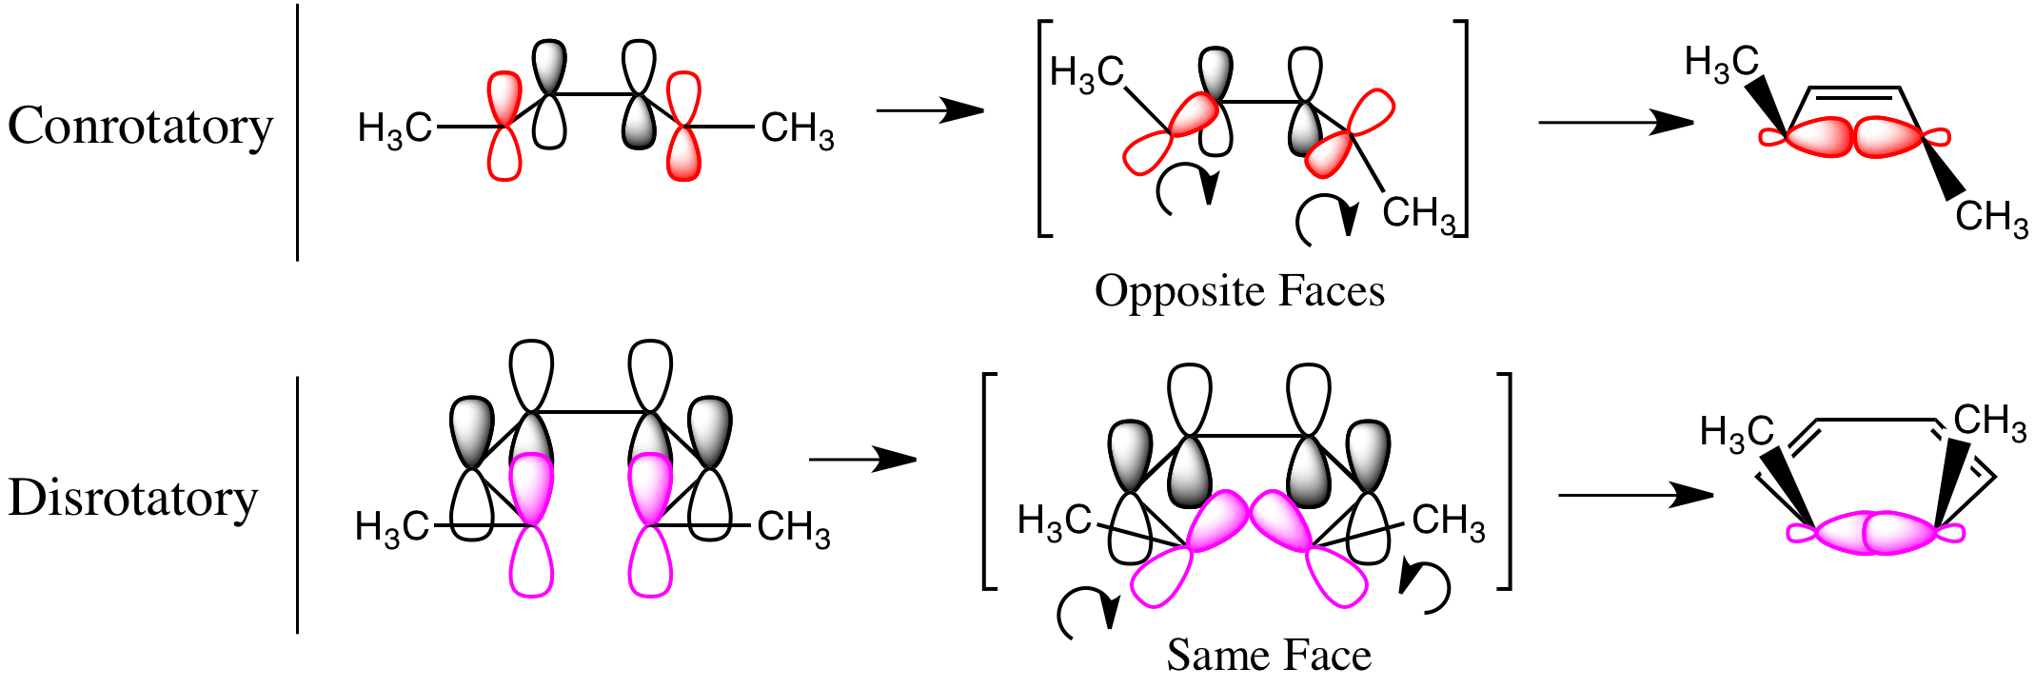
Table 2.5 Electrocyclic Reactions
Allowed, or Preferred Mode |  | Number of Electrons in Cyclic Transition State
Photochemical | Thermal
Disrotatory | Conrotatory | n4
Conrotatory | Disrotatory | n+24
43

Slide 45
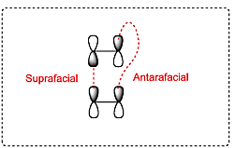
Table 2.6 Cycloaddition Reactions
Allowed, or Preferred Mode |  | Number of Electrons in Cyclic Transition State
Photochemical | Thermal
Suprafacial-suprafacial | Antarafacial-suprafacial | n4
Antarafacial-suprafacial | Suprafacial-suprafacial | n+24
44

Slide 46
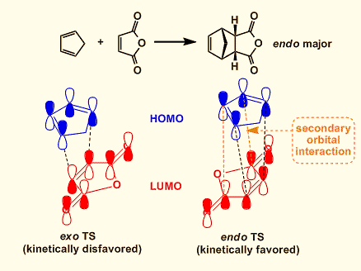
45

Slide 47
Table 2.6 Sigmatropic Reactions
Allowed, or Preferred Mode Hydrogen Migration with |  |  |  | Number of Electrons in Cyclic Transition State
Inversion |  | Retention
Photochemical | Thermal | Photochemical | Thermal
Antarafacial | Suprafacial | Suprafacial | Antarafacial | n4
Suprafacial | Antarafacial | Antarafacial | Suprafacial | n+24
46

Slide 48
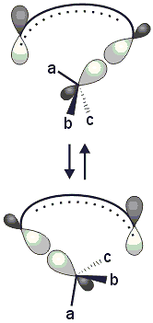
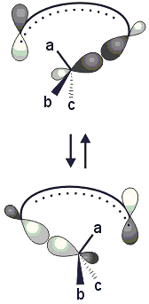
Retention
Inversion
47

